Slide 1
Logistics KPI
Dashboard & Analysis
Presented by K. Gopi Chand

Slide 2
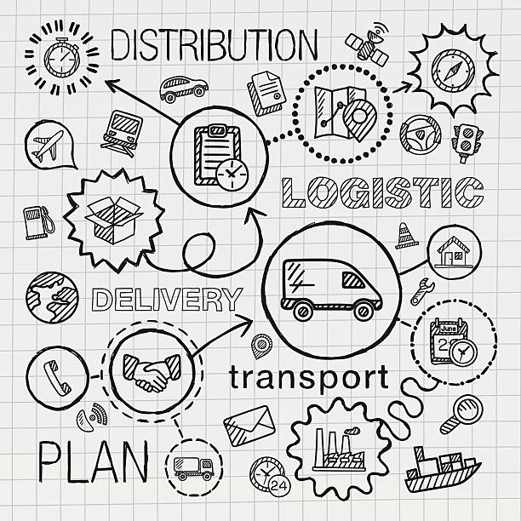
About the project
This project analyses 500 logistics orders across 100 customers and 50 products. The goal is to turn transaction-level data into a clear KPI view for sales, customer, product, city and delivery performance.

Slide 3
Problem
Data visibility
Performance
Operations
500 transaction rows make it difficult to see the overall business story quickly.
Sales, city demand and delivery performance need to be compared in one view.
Delivery status shows 134 late orders, making service-level monitoring important.

Slide 4
Solution
Centralize the data
Create KPIs
Visualize results
Support decisions
Use one analysis-ready Excel sheet.
Build calculated fields with transparent formulas.
Use KPI cards and charts to surface patterns.
Present customer, product, city and delivery insights clearly.

Slide 5




Project overview
Raw data
Derived fields
Customer, order, product, price, quantity and delivery fields.
Price, delivery days, discount %, discounted amount and delivery status.
Analysis
Output
Customer, product, city, coupon and delivery aggregations.
KPI dashboard designed for quick business interpretation.

Slide 6
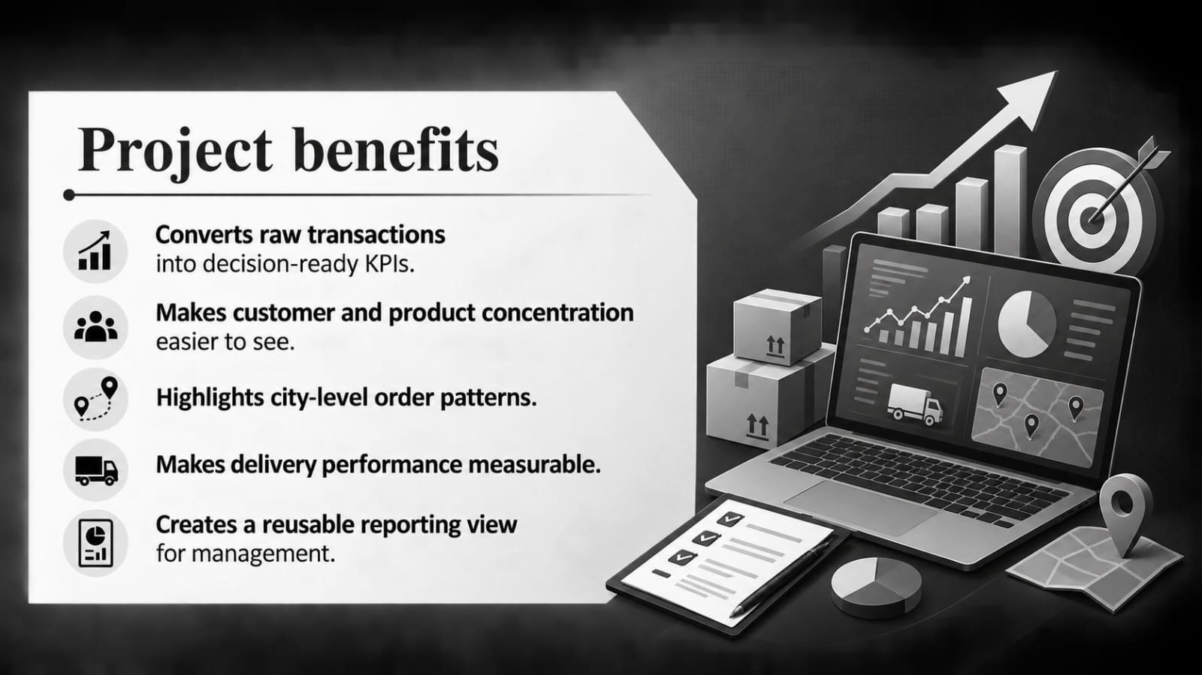

Slide 7
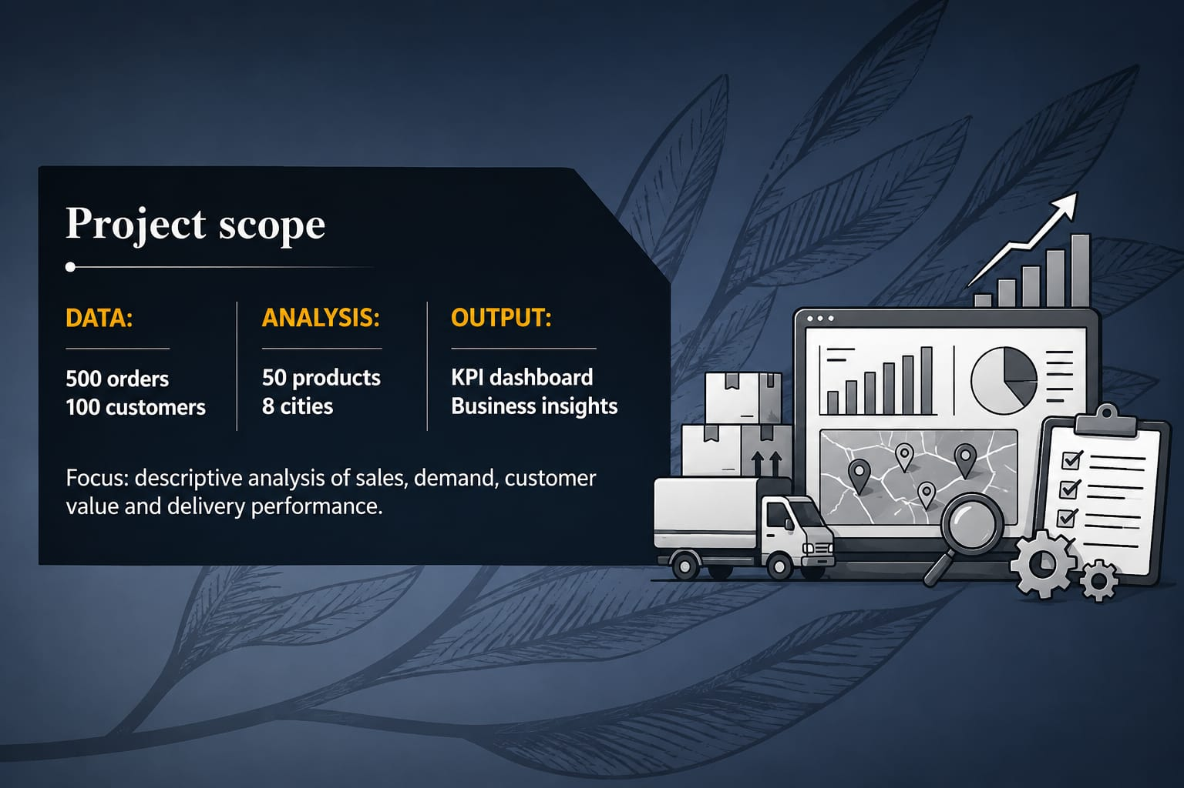
Project scope
DATA:
500 orders
100 customers
ANALYSIS:
50 products
8 cities
OUTPUT:
KPI dashboard
Business insights
Focus: descriptive analysis of sales, demand, customer value and
delivery performance.

Slide 8
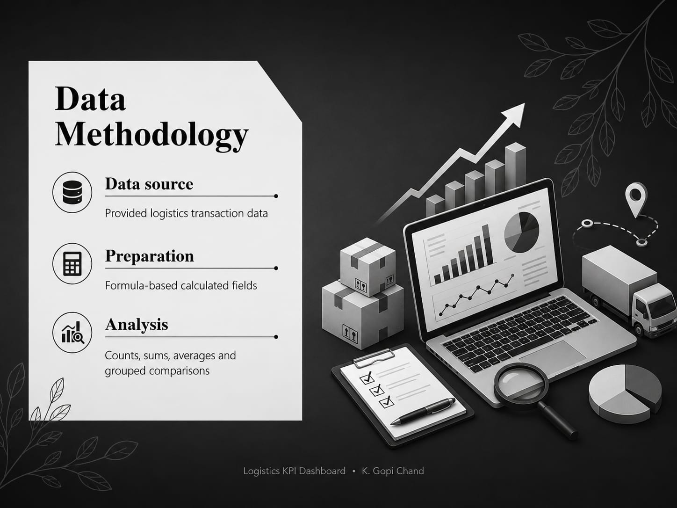
Data Methodology
Data source
Provided logistics transaction data
Preparation
Formula-based calculated fields
Analysis
Counts, sums, averages and grouped comparisons

Slide 9
KPI overview
500
₹3,64,289
4 days
Orders analyses
Total sales
Average delivery
Order-level records
Before discount & delivery
Average actual delivery days

Slide 10
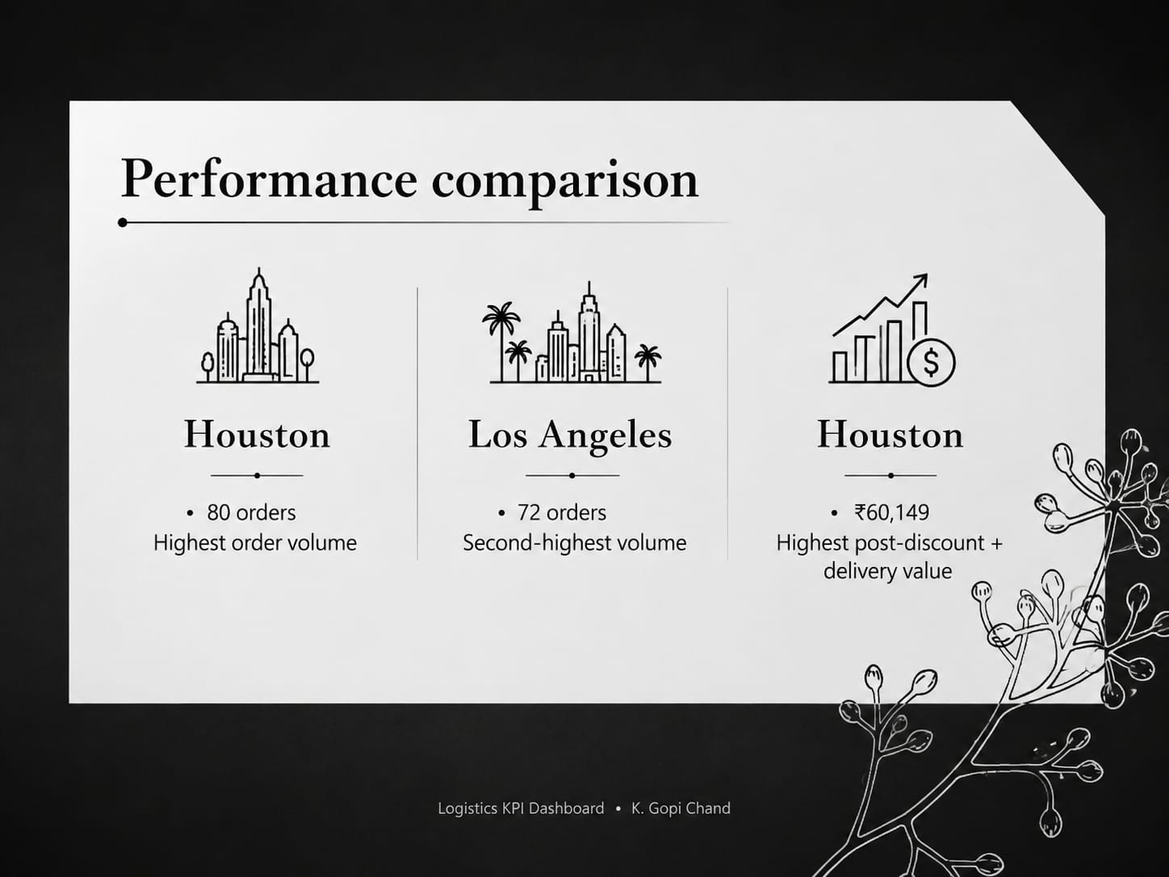
Performance comparison
Houston
Los Angeles
Houston
80 orders
Highest order volume
72 orders
Second-highest volume
₹60,149
Highest post-discount + delivery value

Slide 11
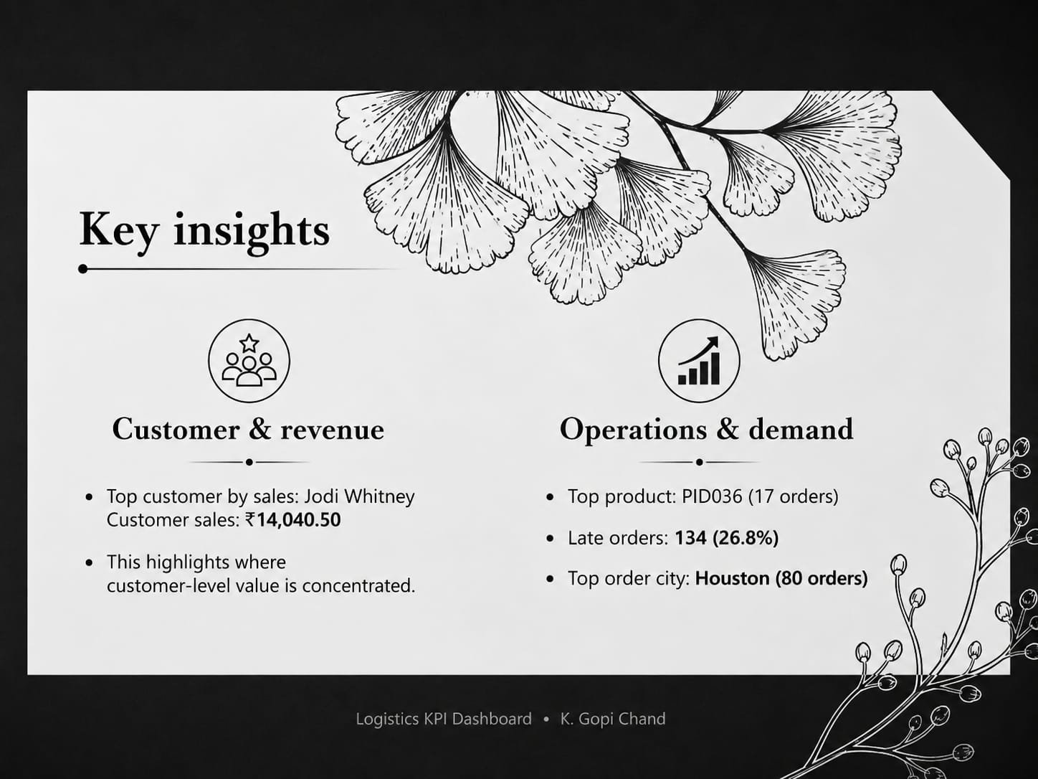
Key insights
Customer & revenue
Operations & demand
Top customer by sales: Jodi Whitney
Customer sales: ₹14,040.50
This highlights where customer-level value is concentrated.
Top product: PID036 (17 orders)
Late orders: 134 (26.8%)
Top order city: Houston (80 orders)

Slide 12
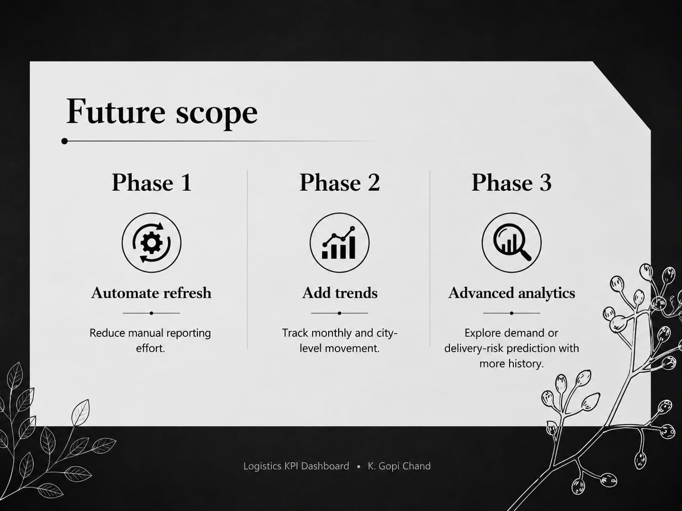
Future scope
Phase 1
Phase 2
Phase 3
Automate refresh
Add trends
Advanced analytics
Reduce manual reporting effort.
Track monthly and city-level movement.
Explore demand or delivery-risk prediction with more history.

Slide 13
KPI score card
KPI | Value | KPI | Value | Interpretation
Customers | 100 | Products | 50 | Coverage
Orders | 500 | Avg age | 42 yrs | Customer profile
Total sales | ₹364,289 | Post-discount + delivery | ₹347,190 | Revenue view
Avg delivery | 4 days | Late orders | 134 | Service level
Before-time | 278 | On-time | 88 | Delivery status
Top city | Houston | Top product | PID036 | Demand concentration
Top customer | Jodi Whitney | Coupon usage | FLAT8 | Customer / promotion
Expenses
Sales & Marketing | 5,062,500​ | 38,400,000​ | 151,200,000​ | 70%
Customer Service | 1,687,500​ | 9,600,000​ | 21,600,000​ | 10%
Product Development | 562,500​ | 2,400,000​ | 10,800,000​ | 5%
Research | 281,250​ | 2,400,000​ | 4,320,000​ | 2%
Total Expenses | 7,593,750​ | 52,800,000​ | 187,920,000​
EBIT | -1,968,750 | -4,800,000 | 28,080,000 | 13%

Slide 14
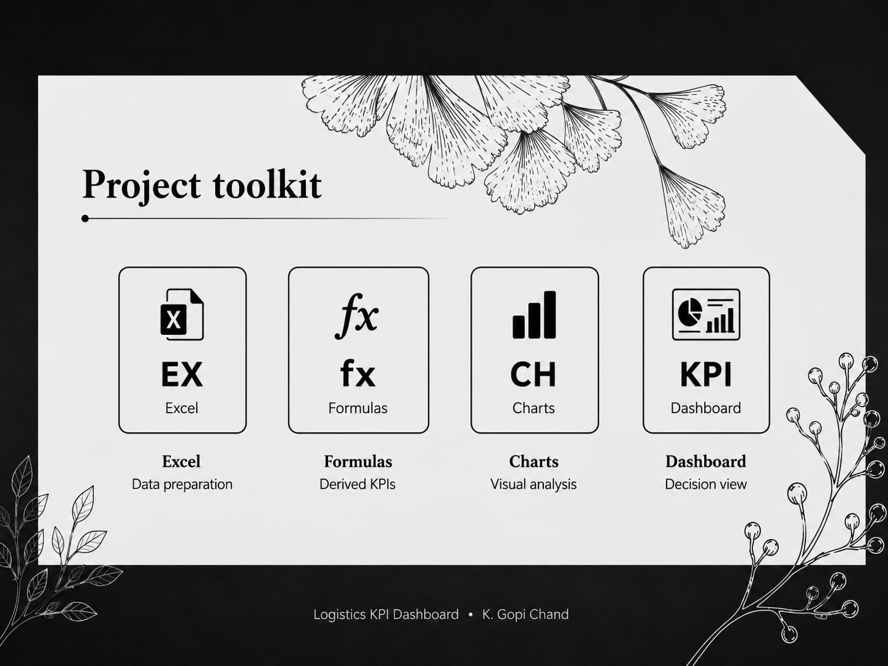

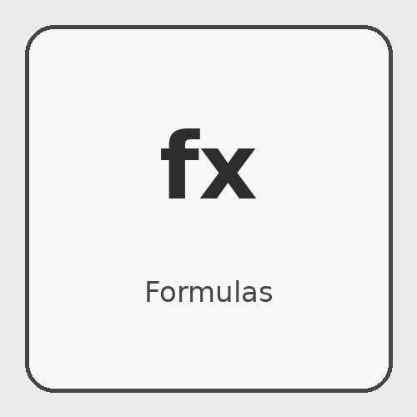

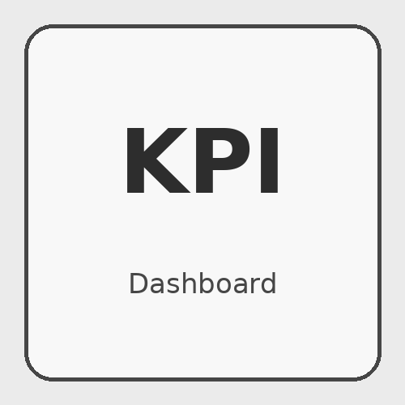
Project toolkit
Excel
Formulas
Charts
Dashboard
Data preparation
Derived KPIs
Visual analysis
Decision view

Slide 15
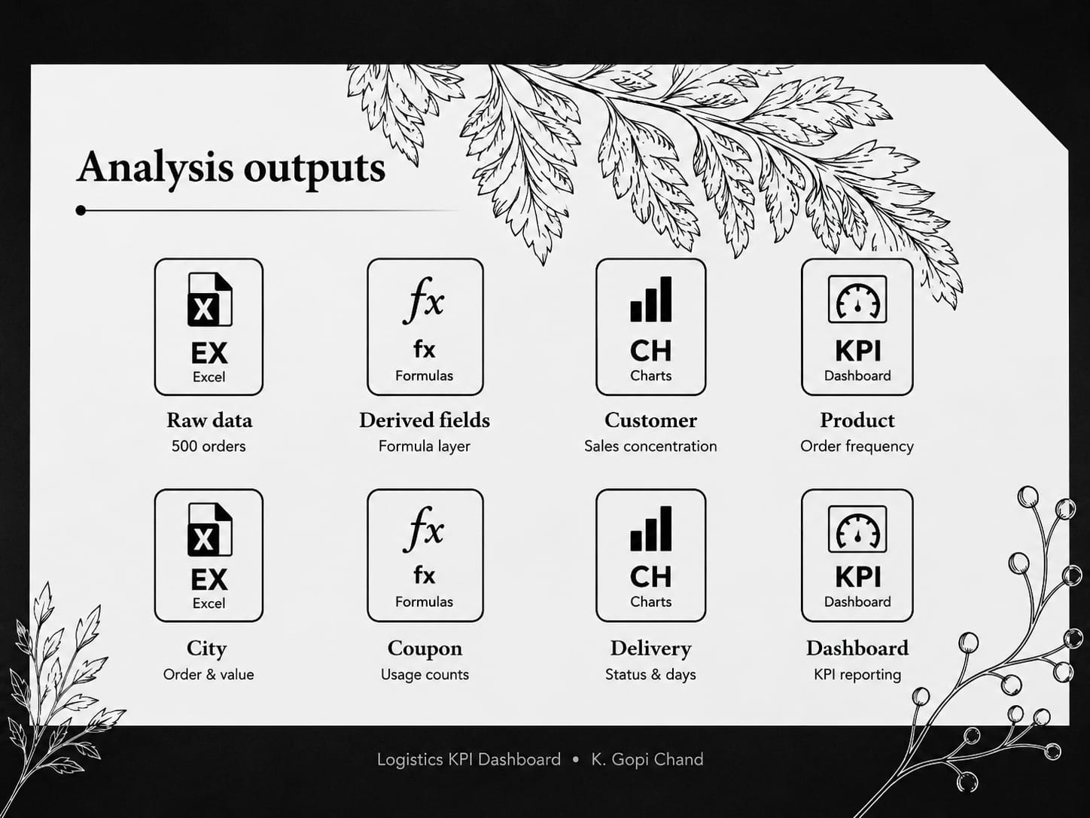
Analysis outputs
Raw data
Derived fields
Customer
Product
500 orders
Formula layer
Sales concentration
Order frequency
City
Coupon
Delivery
Dashboard
Order & value
Status & days
KPI reporting
Usage counts

Slide 16
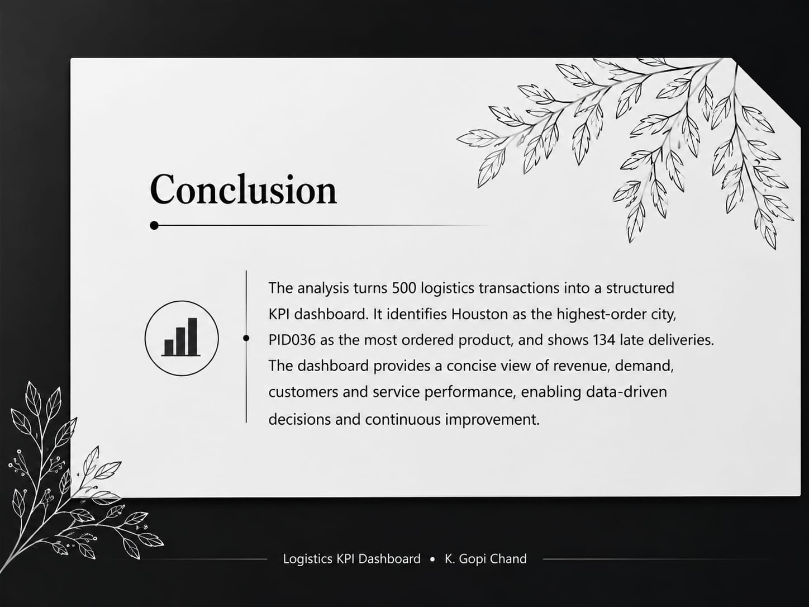
Summary
The analysis turns 500 logistics transactions into a structured KPI dashboard. It identifies Houston as the highest-order city, PID036 as the most ordered product, and shows 134 late deliveries. The dashboard provides a concise view of revenue, demand, customers and service performance.

Slide 17

Thank you

